Slide 1

Flutter Study Jams
Organizer Guide

Slide 2
What is a Study Jam?
A Community Event
Study Jams are community-run study groups for developers. This is a great opportunity to bring members of your community together to learn something in person.
These trainings will give your community members a specific skill they can use for personal development or career advancement.

Slide 3
Why Run a Flutter Study Jam?
Flutter is Google’s portable UI toolkit to build beautiful native apps on iOS and Android from a single codebase. Flutter Study Jams are a great opportunity to bring members of your community together to learn this hot technology in person.
Who should attend?
Flutter Study Jam is suited best for:
1) those just getting started with mobile app development
2) those with programming experience on other mobile app frameworks

Slide 4
Organizing a Flutter Study Jam

Slide 5
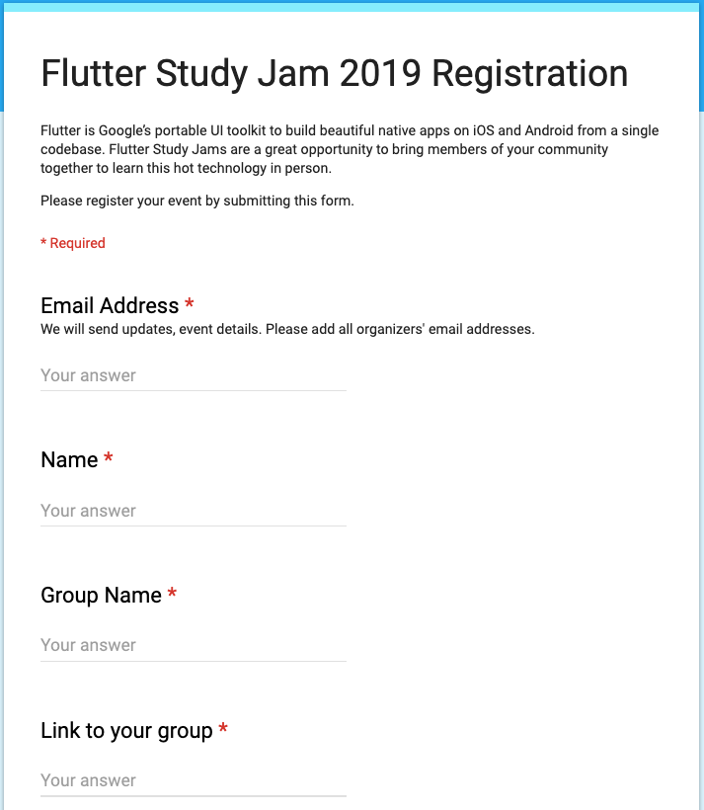
Submit event registration form
Register your event by submitting this form: bit.ly/flutter-study-jam19
If you are a part of GDG, WTM or DSC :
Sponsorship may be available based on your event details. Your regional lead will connect you about event support.

Slide 6

Register your event on Meetup.com*
*This step is mandatory for GDGs.
When entering your event details...
The event title must contain the words “Flutter Study Jam”.
Feel free to write your own event description or copy parts or all of the sample description on the next page.

Slide 7
Example Description*
Flutter is Google’s portable UI kit for crafting high-quality native interfaces on iOS and Android in record time. Flutter works with existing code, is used by developers and organizations around the world, and is free and open source.
Want to get started on building Flutter apps?
Join us for our Flutter Study Jam! Together we'll work through Flutter codelabs prepared by Google instructors. You will be able to get hands-on experience with Flutter and build a Flutter app while learning the fundamentals..
Agenda:
Bring a laptop! The course will run on all of the latest versions of the popular browsers. For the best experience, the laptop should have Flutter installed on it prior to starting the study jam to save time. Windows/Linux/Mac would all be fine. Check out : https://flutter.dev/docs/get-started/install
Agenda:
6:00pm: Flutter Introduction
6:45pm: Break
7:00pm: Write Your First Flutter App, part 1
9:00pm: Event ends
* This is a sample description. Feel free to personalize to your community.

Slide 8
Starting Point
If your attendees are new to Flutter, start with Flutter Introduction.
Flutter introduction slide templates
You can also use the Dart codelab if you want to get your attendees familiar with Dart
Dart codelab

Slide 9
Option 1
Build your first Flutter app with the following 2 codelabs :
Write Your First Flutter App, part 1
Write Your First Flutter App, part 2
You'll implement a simple mobile app that generates proposed names for a startup company. And you will learn :
How to write a Flutter app that looks natural on both iOS and Android.
Basic structure of a Flutter app.
Finding and using packages to extend functionality.
Using hot reload for a quicker development cycle.
How to implement a stateful widget.
How to create an infinite, lazily loaded list.
In part 2 of, you'll add interactivity, modify the app's theme, and add the ability to navigate to a new page (called a route in Flutter).

Slide 10
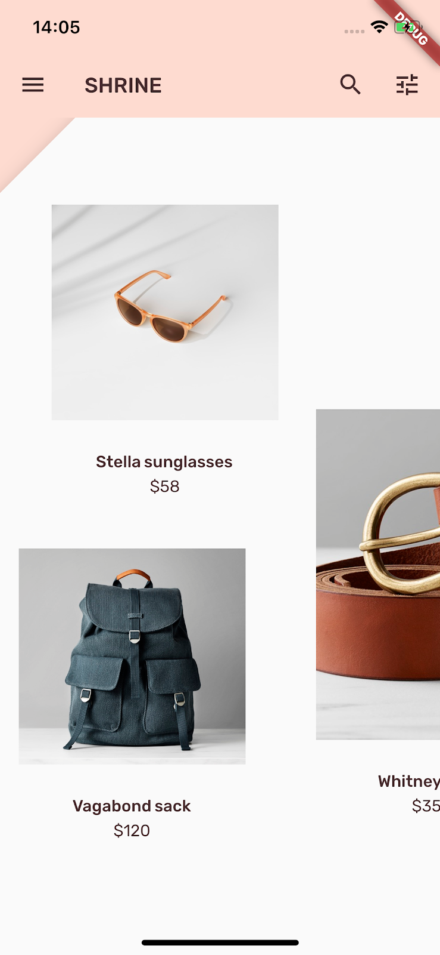
Option 2
Learn how to create beautiful UIs using Material Components and Flutter.
You will build Shrine, an e-commerce app, that sells clothing and home goods. The following 4 codelabs will guide you through building the app and will demonstrate how you can customize components to reflect any brand or style using Material Components for Flutter.
We recommend that you do all of the codelabs in order as they progress through tasks step-by-step.
MDC-101 Flutter: Material Components (MDC) Basics
MDC-102: Material Design Structure and Layout
MDC-103: Material Design Theming with Color, Shape, Elevation and Type
MDC-104: Material Design Advanced Components

Slide 11
Option 3
Continue with this codelab for a deeper dive into Flutter.
Building Beautiful UIs with Flutter
You'll learn
How to write a Flutter app that looks natural on both iOS and Android.
How to debug your Flutter app.
How to run your Flutter app on a simulator/emulator and on a device.
Option 4
Use your own content to create an app with your members.

Slide 12
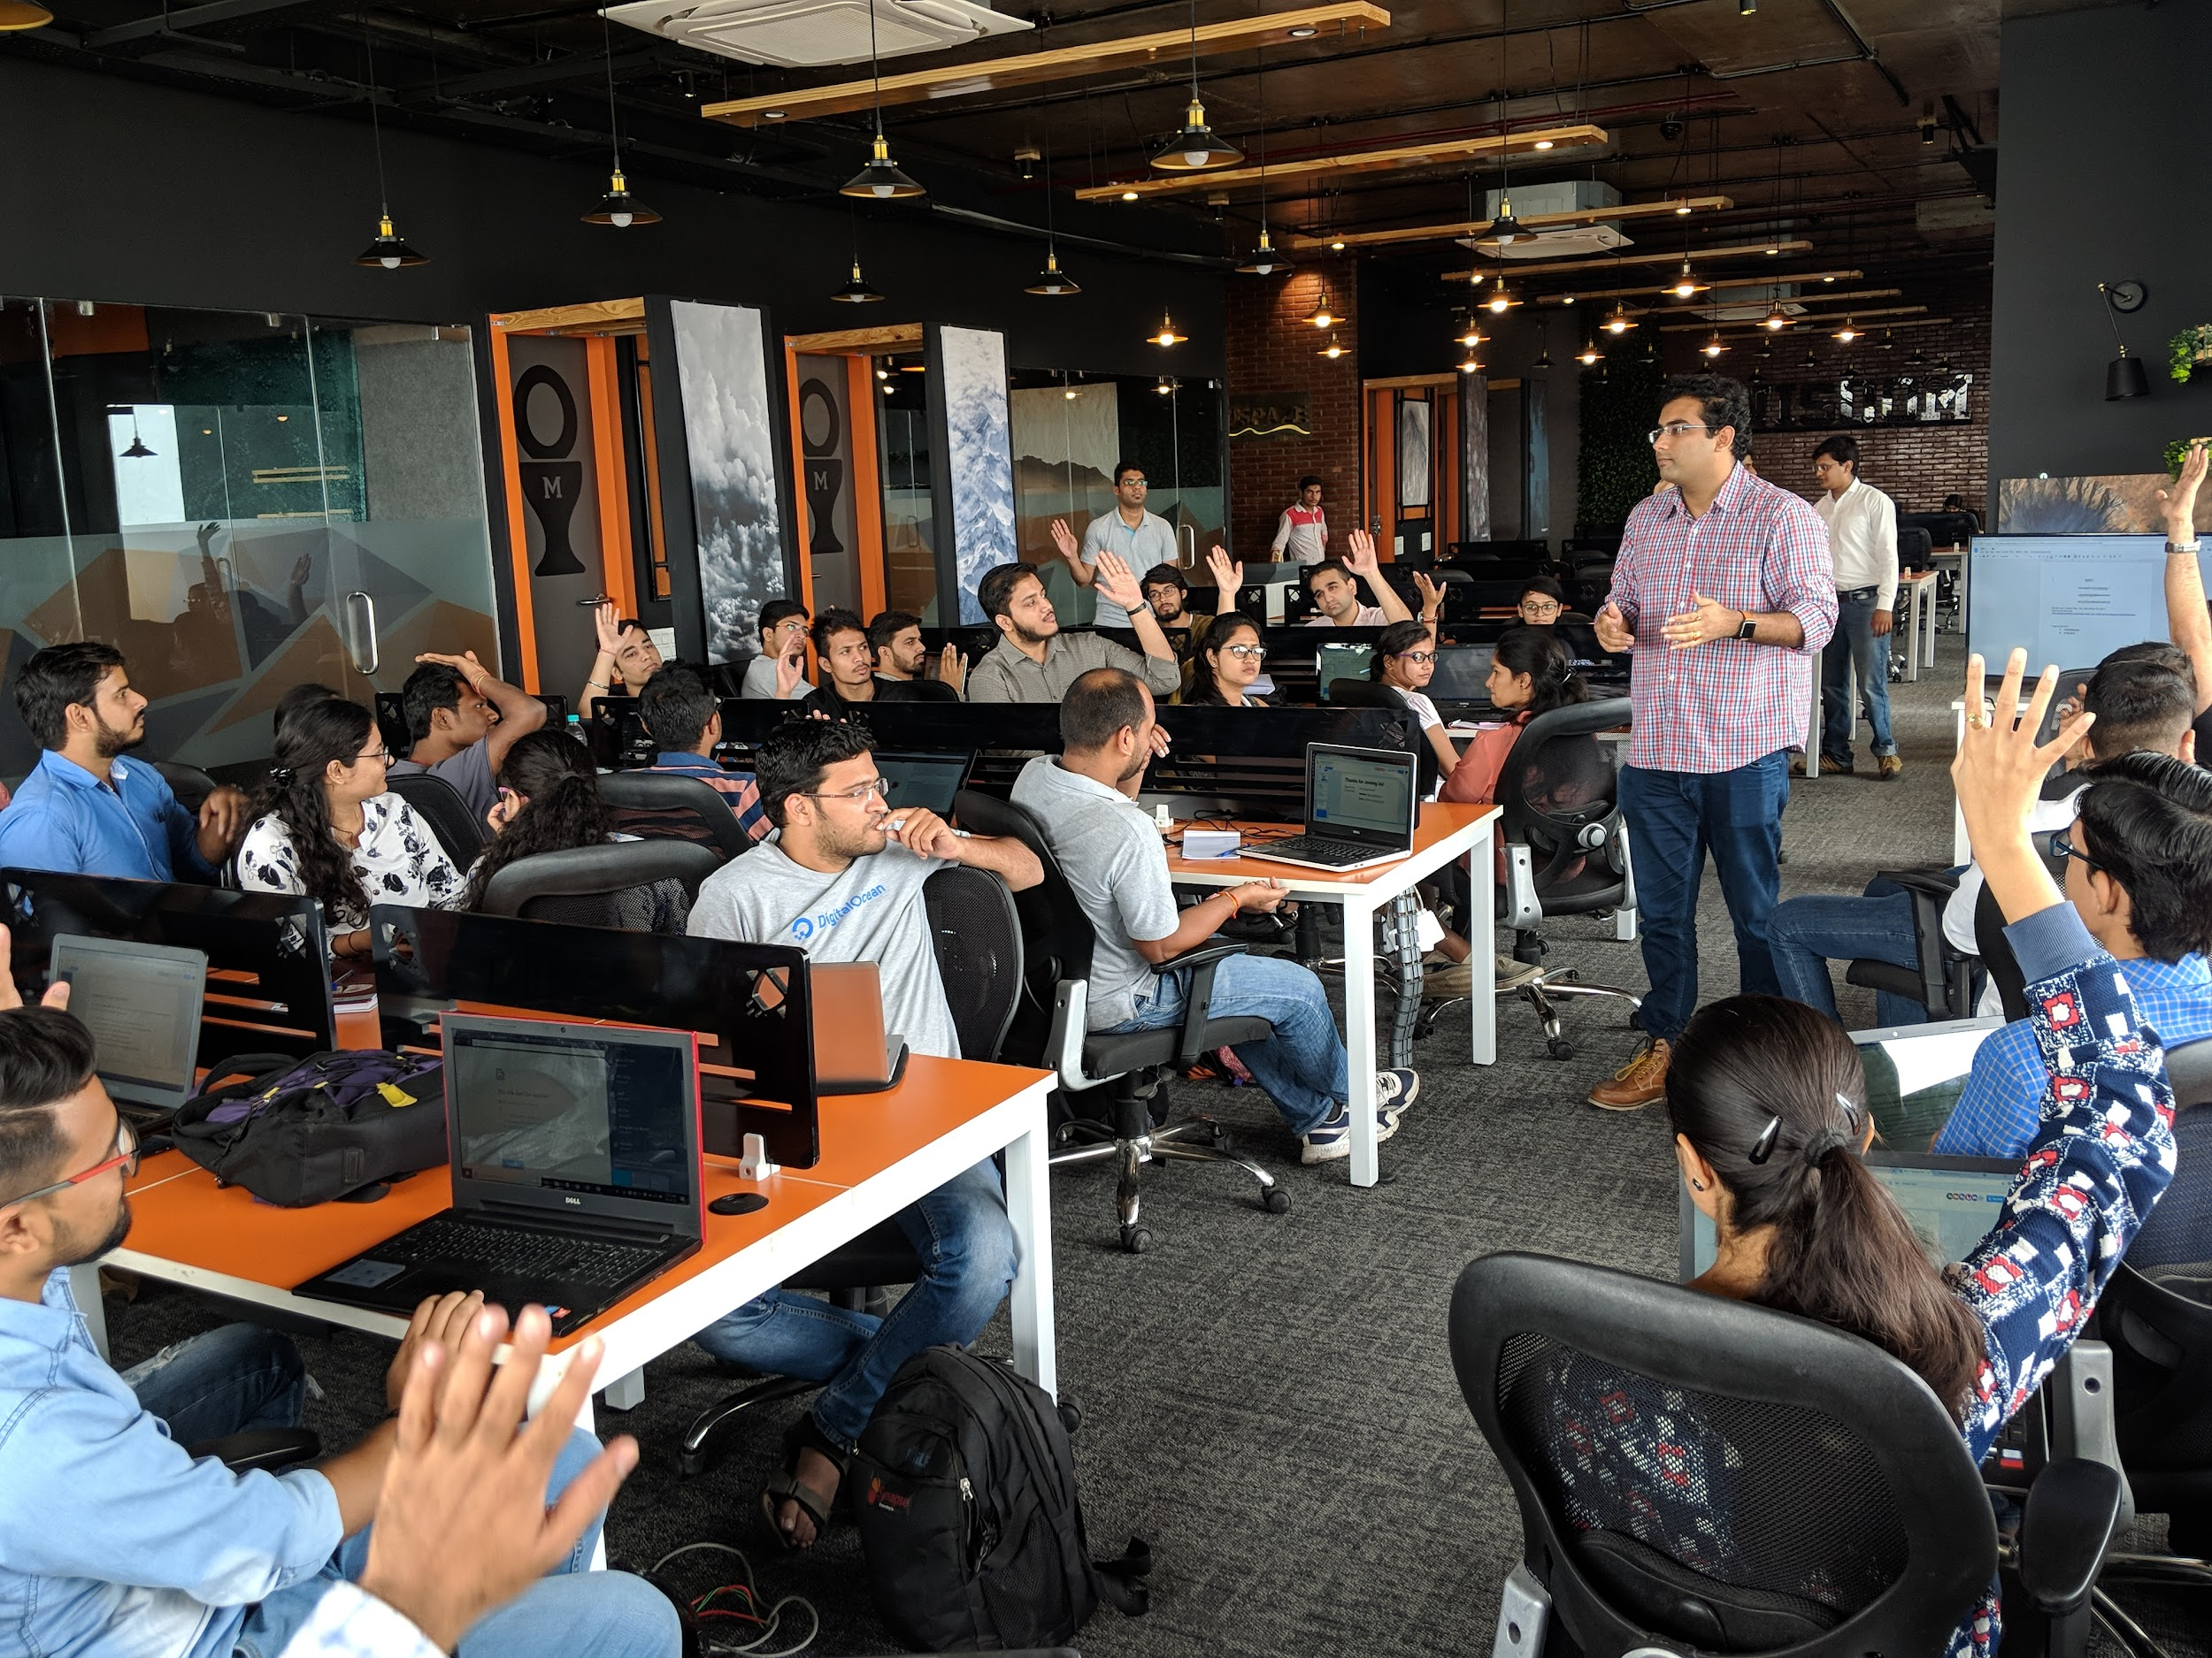
Find a venue
Find a venue which has:
Internet connection, wifi or ethernet. The codelabs require a connection to run.
Chairs and tables. Attendees will be using their laptops.
Power outlets. The event will run for about three hours.
Optional: A projector that the Facilitator can use to share their screen with attendees.
GDG New Brunswick, 2018

Slide 13
Get familiar with the content
Check out Flutter Introduction slides, and give a Flutter intro if you think it will be useful. Feel free to use template slides.
Check out Flutter Codelabs to plan your events.
Check if you and other facilitators have access to the flutter-study-jam mailing list. If you don’t, request access by clicking the link above and then the Apply for membership link. Include your group’s name in your request.
Make sure you have email delivery turned on, as important updates to the Flutter Study Jam will be shared with this mailing list.

Slide 14

Together, as a team
Set up online channel for attendees. Pick one that works in your community. Use this channel to share the slides and encourage your attendees to complete the codelabs at home.
Make sure you invite your attendees to join the conversation! Some possibilities:
Comments field on Meetup.com
Facebook group
Mailing list
Slack channel
Remind attendees to post using #FlutterStudyJam

Slide 15
Celebrate graduation!
The next time your group has an in-person meeting, review the Flutter Study Jam that you completed together.
You might ask anyone in the audience who earned at least one badge to come up and then give everyone a round of applause.
Your attendees have worked hard and learned a lot. They deserve to be celebrated, and so do you!

Slide 16
Submit the organizer survey
*This step is mandatory for GDGs.
If you are a GDG, please complete the regular post-event reporting form you will receive after the event.
For all other groups, when you have completed the in-person event, please submit the Organizer Survey:
https://goo.gl/forms/gBGU0dZK6vkzzY6Q2
You are the expert on what works in your community. We want to hear from you, so future Study Jams will be even more awesome for you and your members!

Slide 17


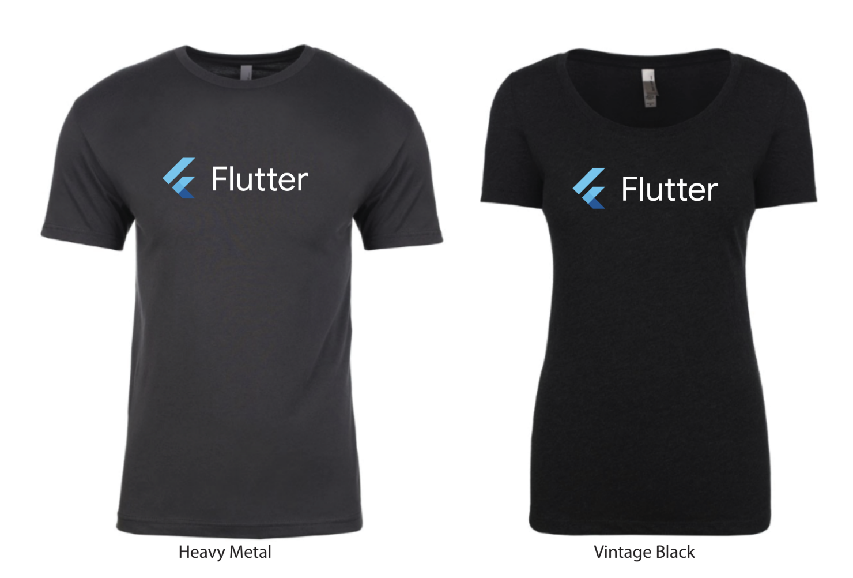
SWAG
Flutter logo assets for SWAG to print SWAG
You can print following examples or print your own SWAG. Please check out guidelines to use Flutter logo.
Recommended size : 3.5" x 1.12"
You can upload this design to stickermule.com and place an order.

Slide 18
Flutter codelabs
Flutter intro slides
Flutter get started docs
Event registration form
Flutter and Dart logos
Contact nyener@google.com for any questions

Slide 19
That’s a wrap.

